Slide 1
Set theory ch 9 arithmetic of the ordinal numbers
Mirjam Nilsson

Slide 2
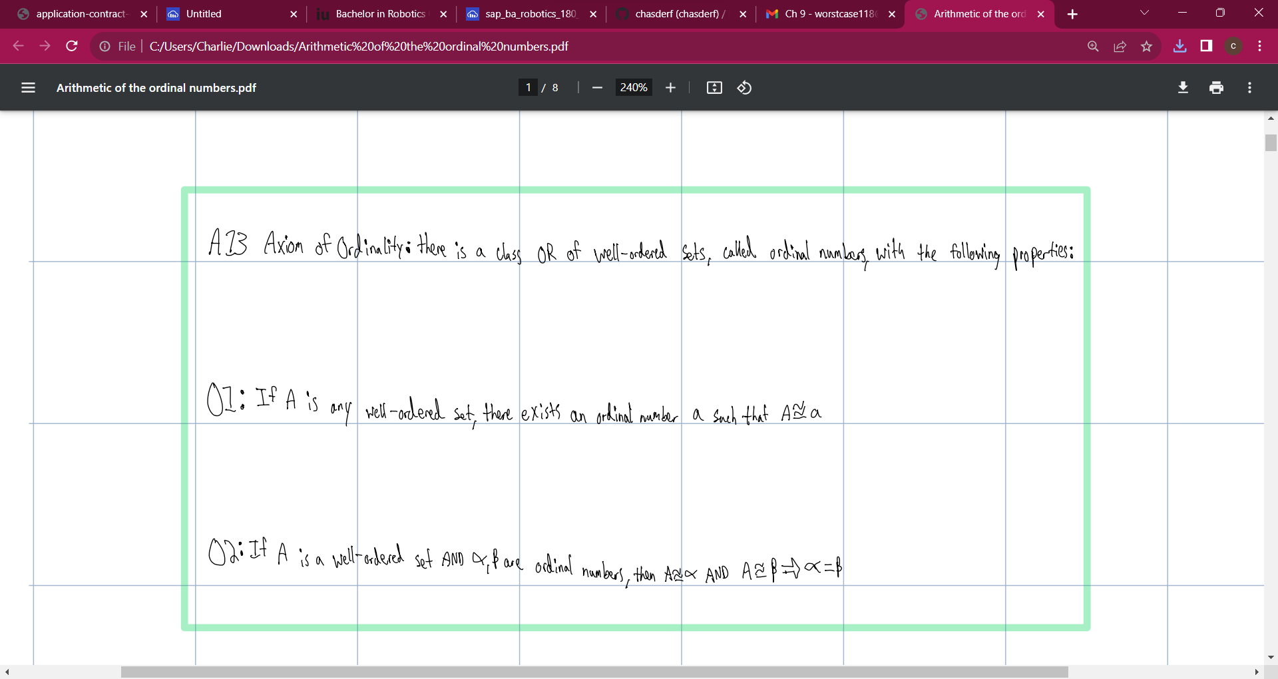
ABOUT US
At Contoso, we empower organizations to foster collaborative thinking to further drive workplace innovation. By closing the loop and leveraging agile frameworks, we help business grow organically and foster a consumer-first mindset.

Slide 3
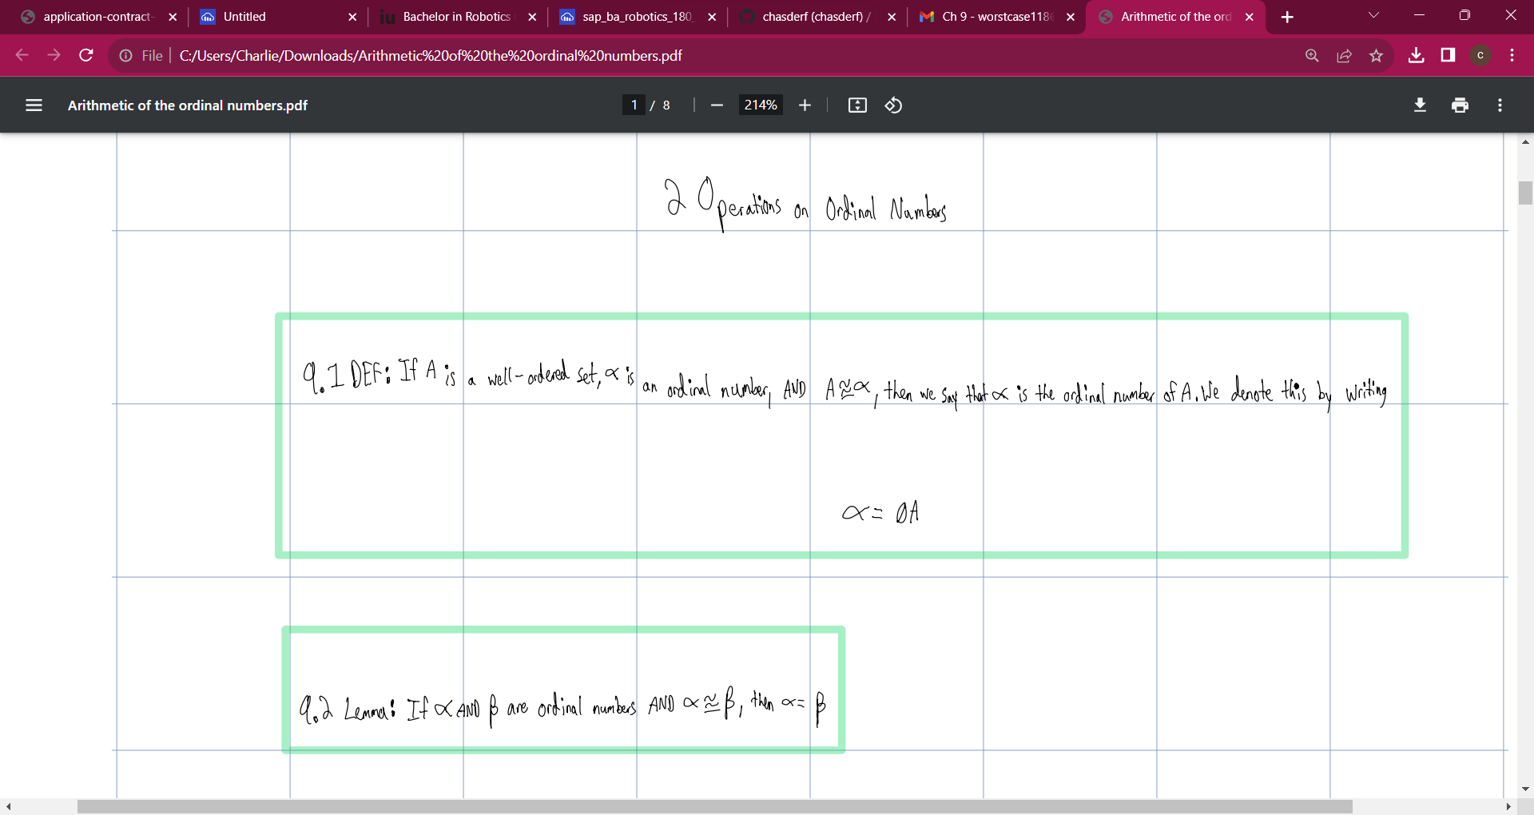
PROBLEM
MARKET GAP
COSTS
Few, if any, products on the market help customers like we do
Loss of productivity costing consumers thousands of dollars
CUSTOMERS
USABILITY
66% of US consumers spend money on multiple products that only partially resolves their issue
Customers want something easy to use that helps make their life easier

Slide 4
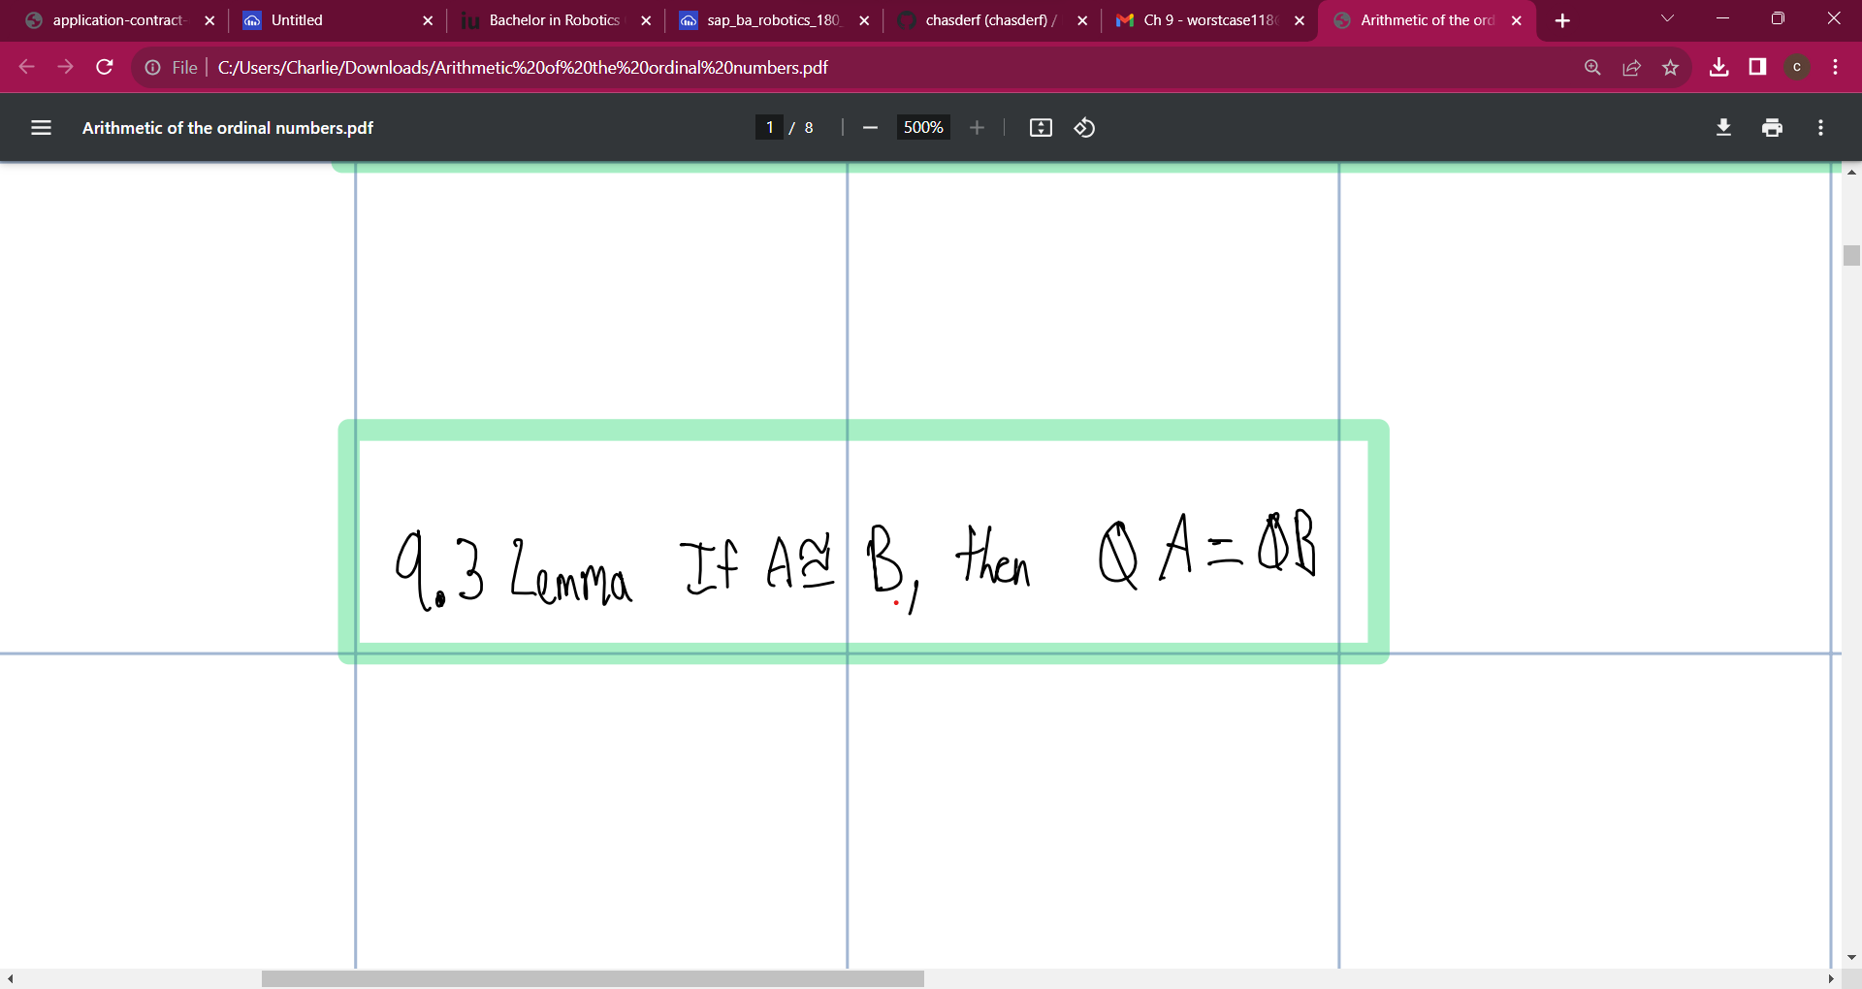
SOLUTION
CLOSE THE GAP
TARGET AUDIENCE
Our product makes consumer lives easier, and no other product on the market offers the same features
Gen Z (18-25 years old)
COST SAVINGS
EASY TO USE
Reduce expenses for replacement products
Simple design that gives customers the targeted information they need

Slide 5
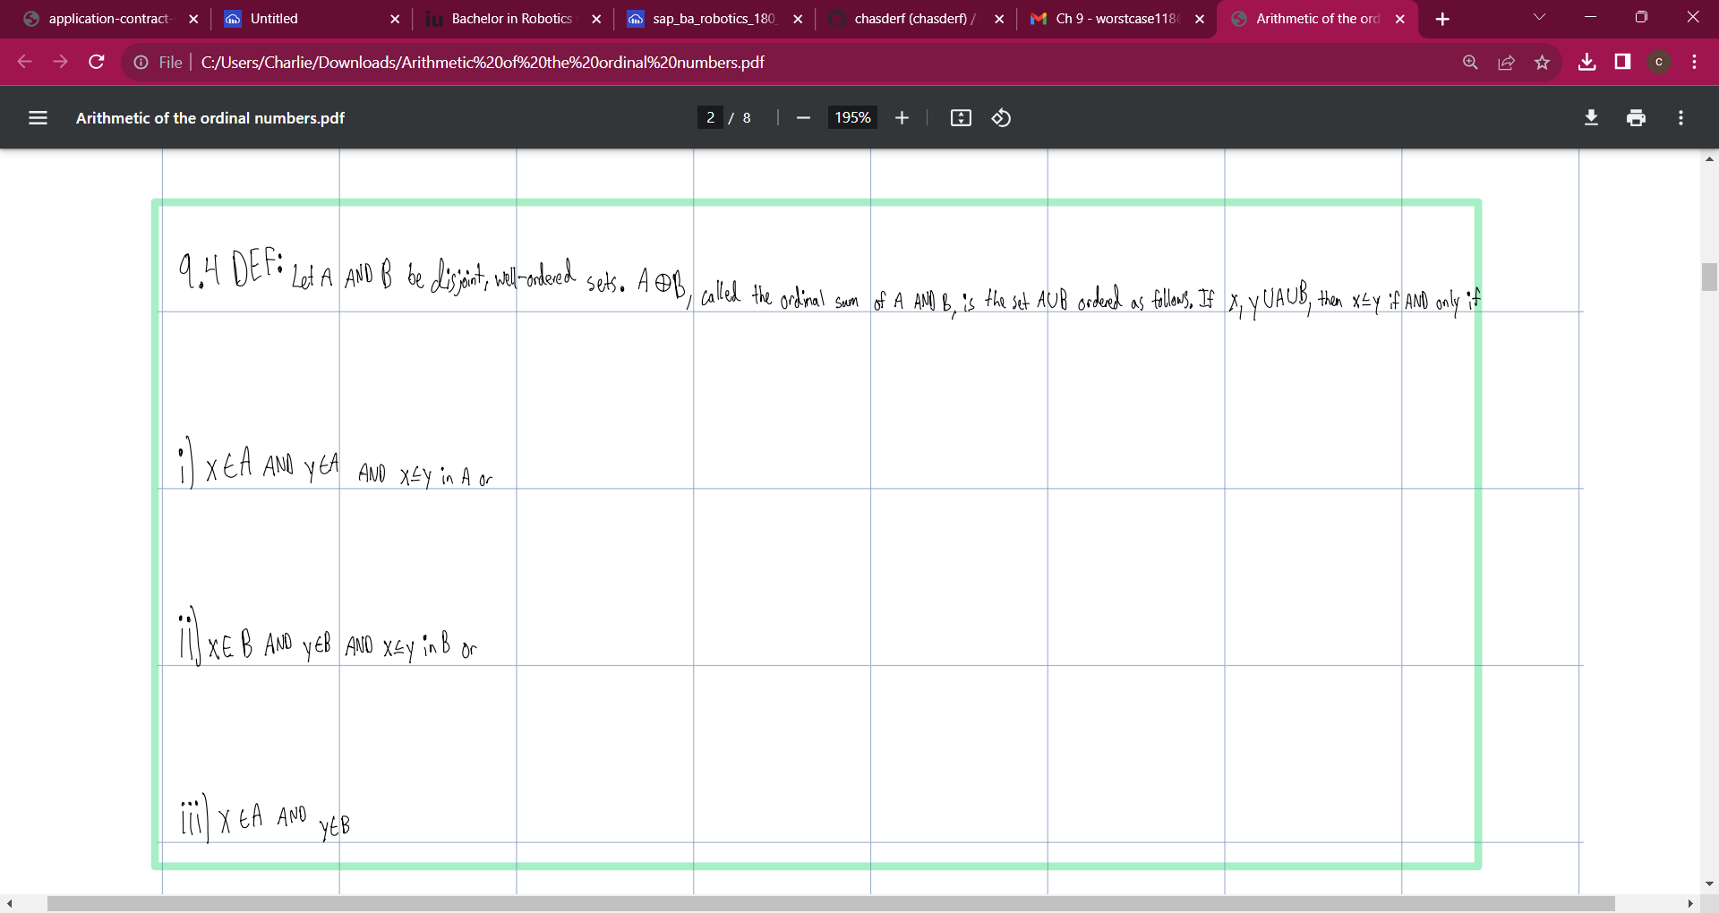
Product overview
UNIQUE
FIRST TO MARKET
Only product specifically dedicated to this niche market
First beautifully designed product that's both stylish and functional
TESTED
AUTHENTIC
Conducted testing with college students in the area
Designed with the help and input of experts in the field

Slide 6
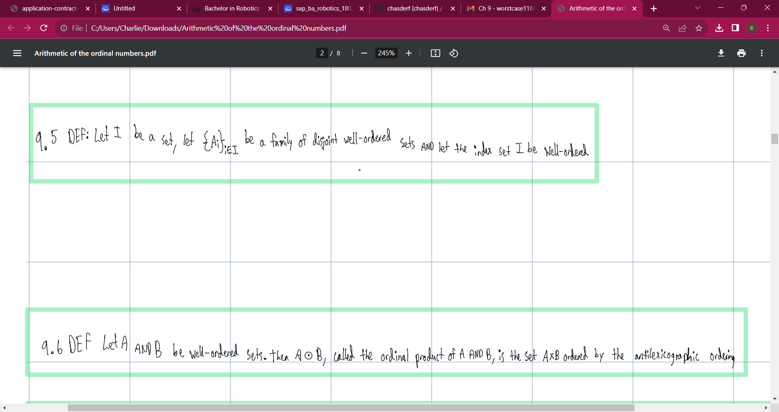
PRODUCT BENEFITS
Cool and stylish product
Areas for community connections
Online store and market swap

Slide 7
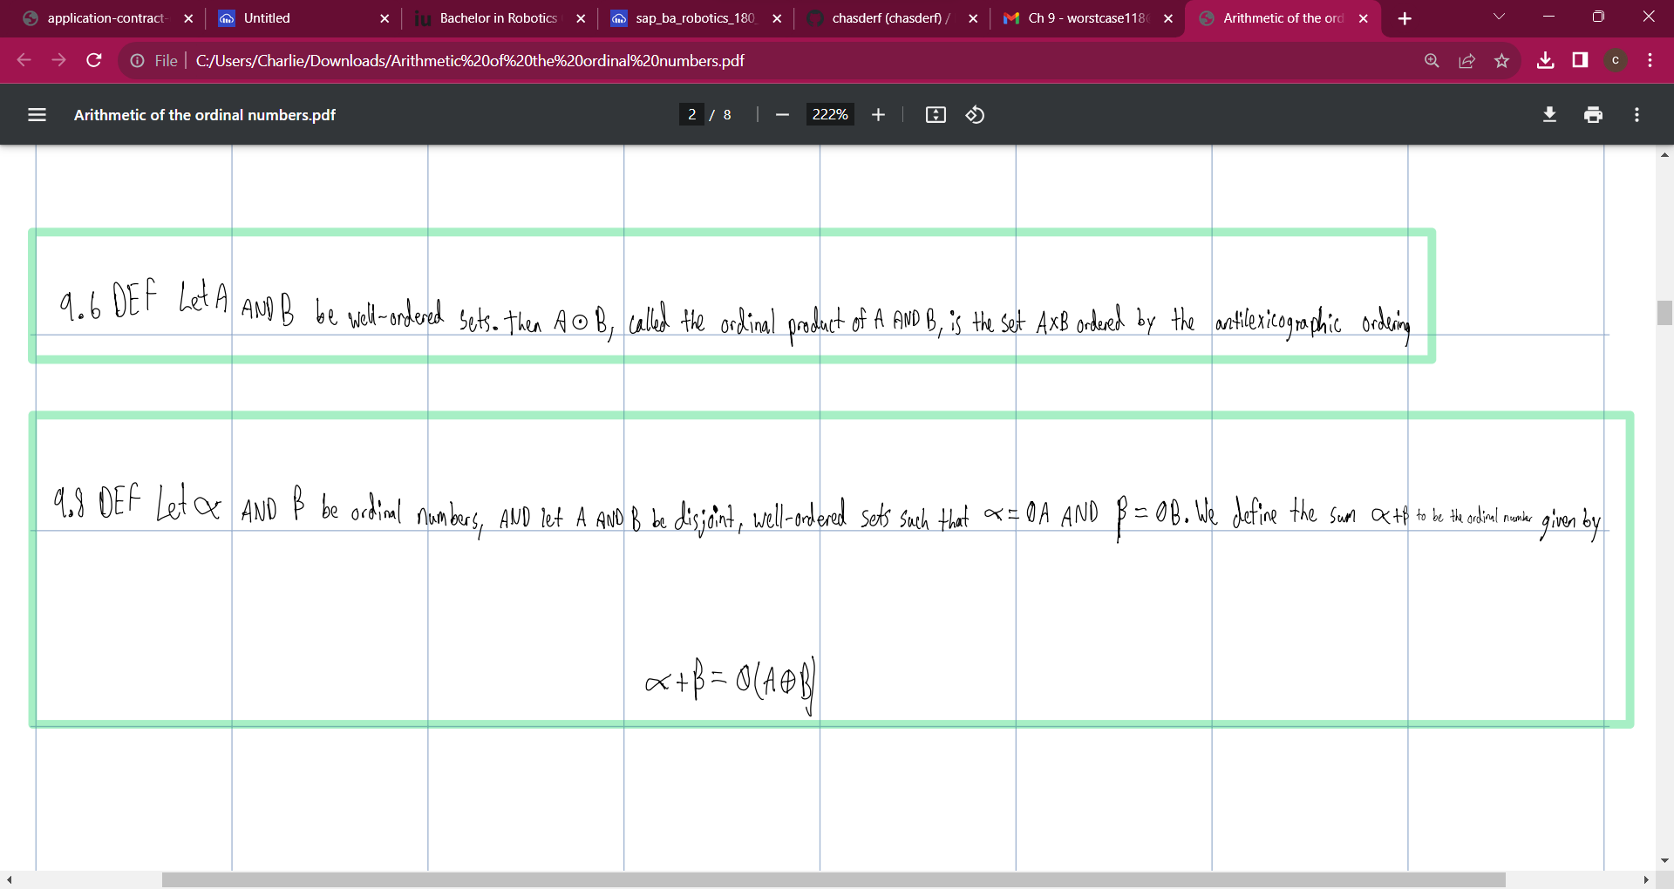
Title and content
At Contoso, we empower organizations to foster collaborative thinking to further drive workplace innovation. By closing the loop and leveraging agile frameworks, we help business grow organically and foster a consumer-first mindset.

Slide 8
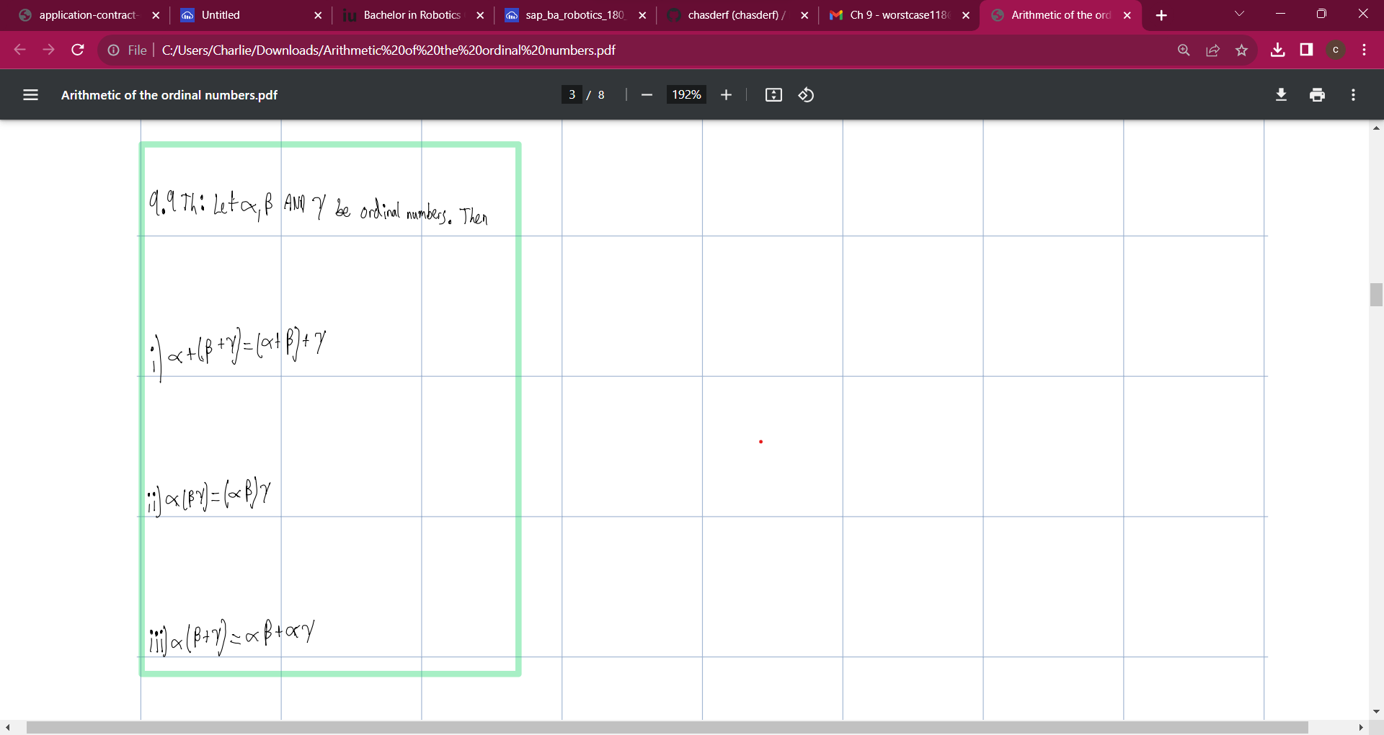
Title and content
At Contoso, we empower organizations to foster collaborative thinking to further drive workplace innovation.
By closing the loop and leveraging agile frameworks, we help business grow organically and foster a consumer-first mindset.

Slide 9

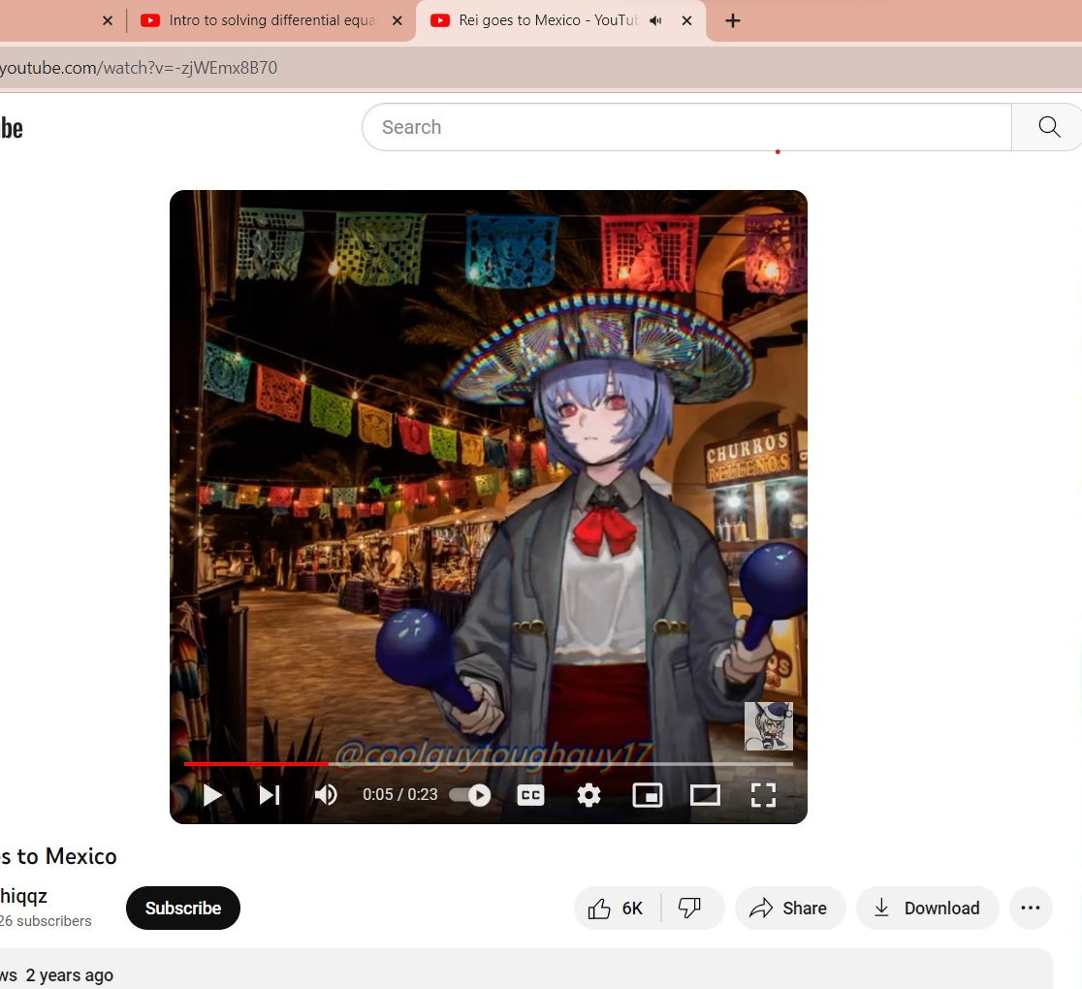
COMPANY OVERVIEW

Slide 10
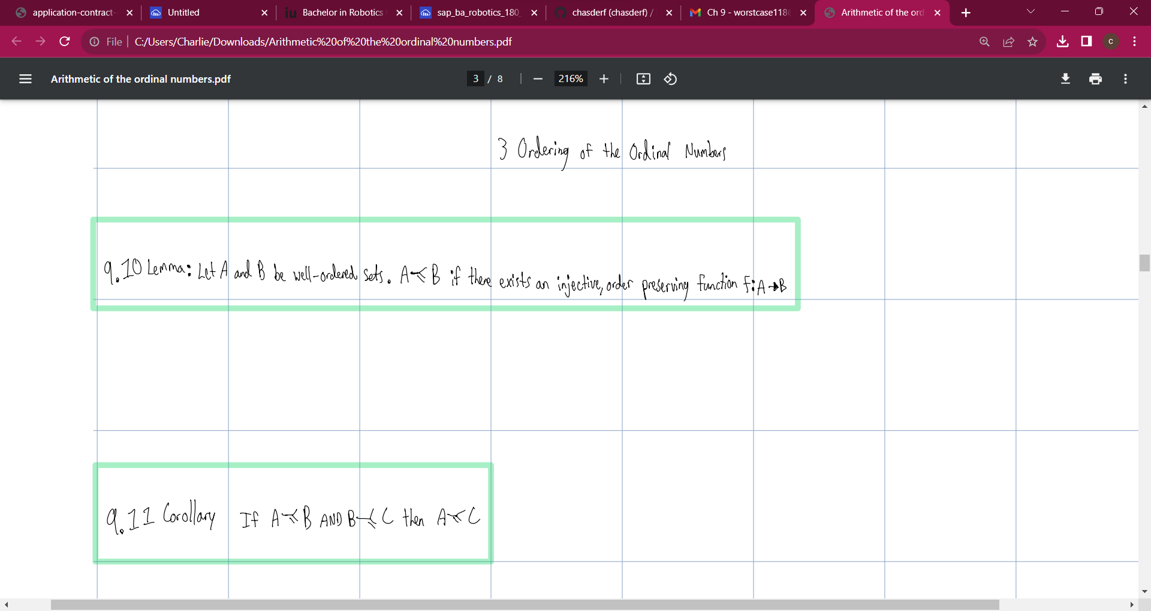



BUSINESS MODEL
RESEARCH
ABSTRACT
DESIGN
We based our research on market trends and social media
We believe people need more products specifically dedicated to this niche market
Minimalist and easy to use

Slide 11
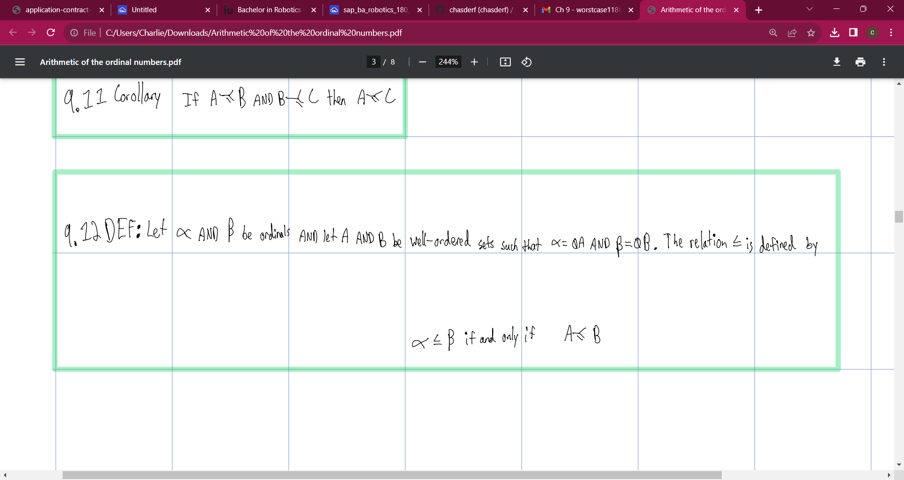
MARKET OVERVIEW
$3B
$2B
$1B
Opportunity to build
Fully inclusive market
Total addressable market
Freedom to invent
Selectively inclusive market
Serviceable available market
Few competitors
Specifically targeted market
Serviceable obtainable market

Slide 12
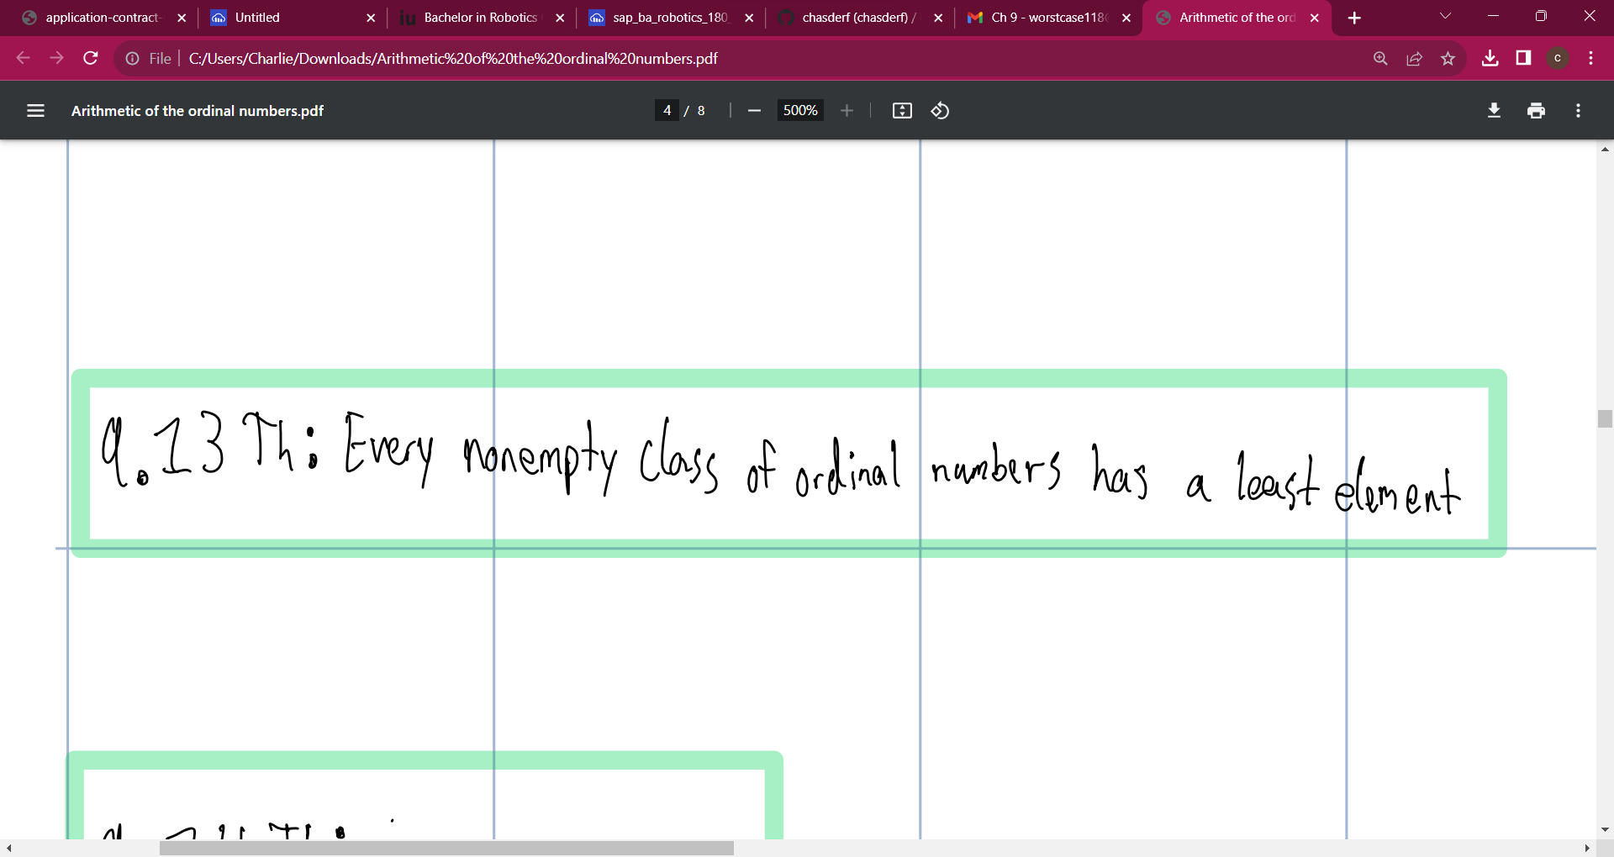
MARKET COMPARISON
$3B
Opportunity to build + addressable market
$2B
Freedom to invent + serviceable market
$1B
Few competitors + obtainable market

Slide 13
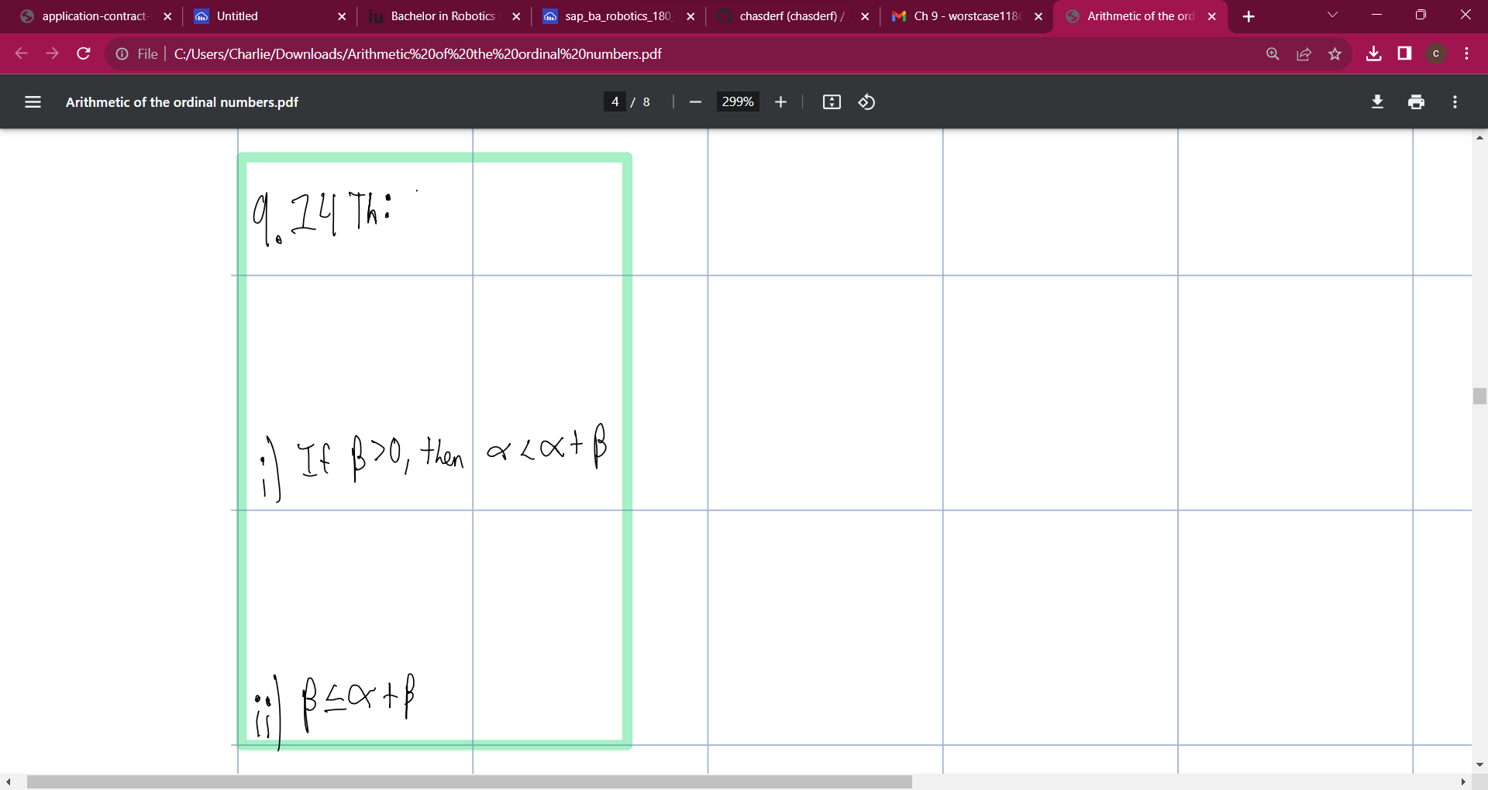
OUR COMPETITION
CONTOSO
COMPETITORS
Our product is priced below that of other companies on the market
Design is simple and easy to use, compared to the complex designs of the competitors
Affordability is the main draw for our consumers to our product
Company A Product is more expensive
Companies B & C Product is expensive and inconvenient to use
Companies D & E Product is affordable, but inconvenient to use

Slide 14
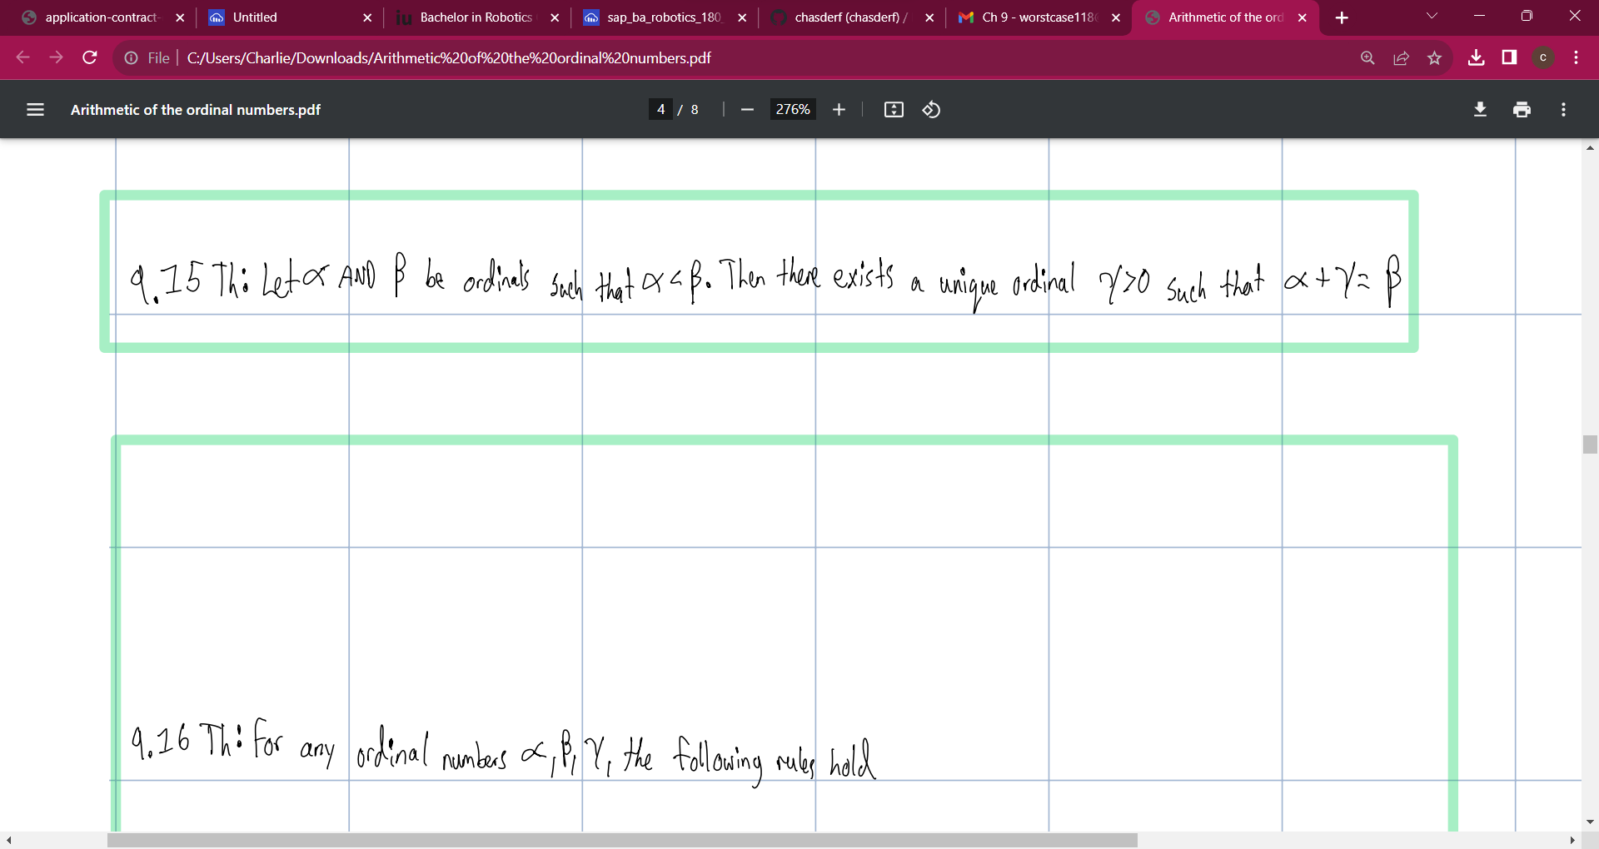
OUR COMPETITION GRAPHIC
CONVENIENT
CONTOSO
A
EXPENSIVE
AFFORDABLE
D
C
INCONVENIENT
E
B

Slide 15
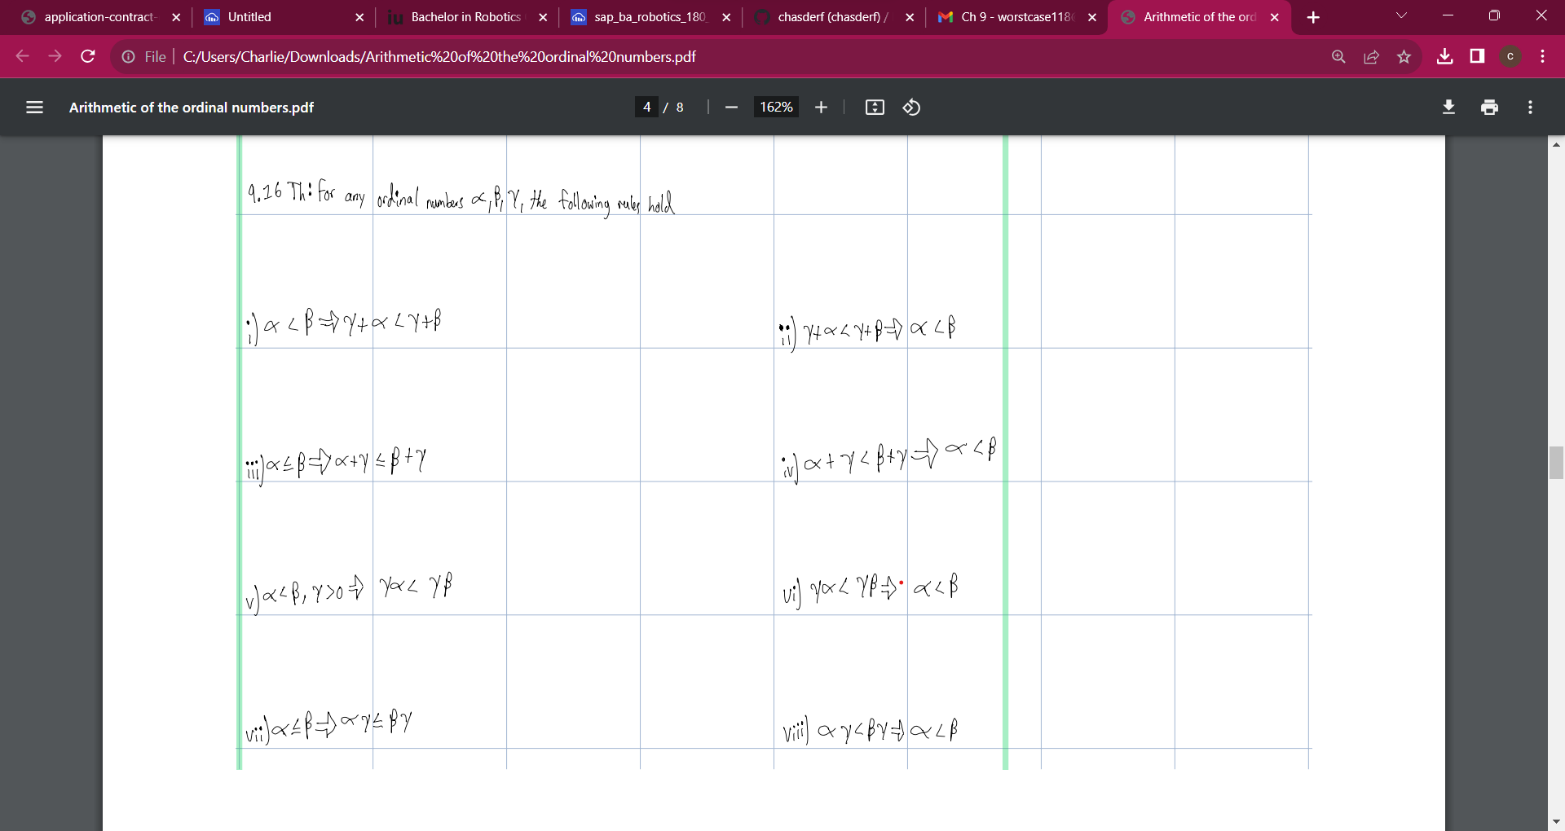
GROWTH STRATEGY
How we’ll scale in the future
PHASE 1: FEB 20XX
Roll out product to high profile or top-level participants to help establish the product
PHASE 2: MAY 20XX
Release of the product to the public and monitor press release and social media accounts
PHASE 3: OCT 20XX
Gather feedback and adjust product design as necessary

Slide 16
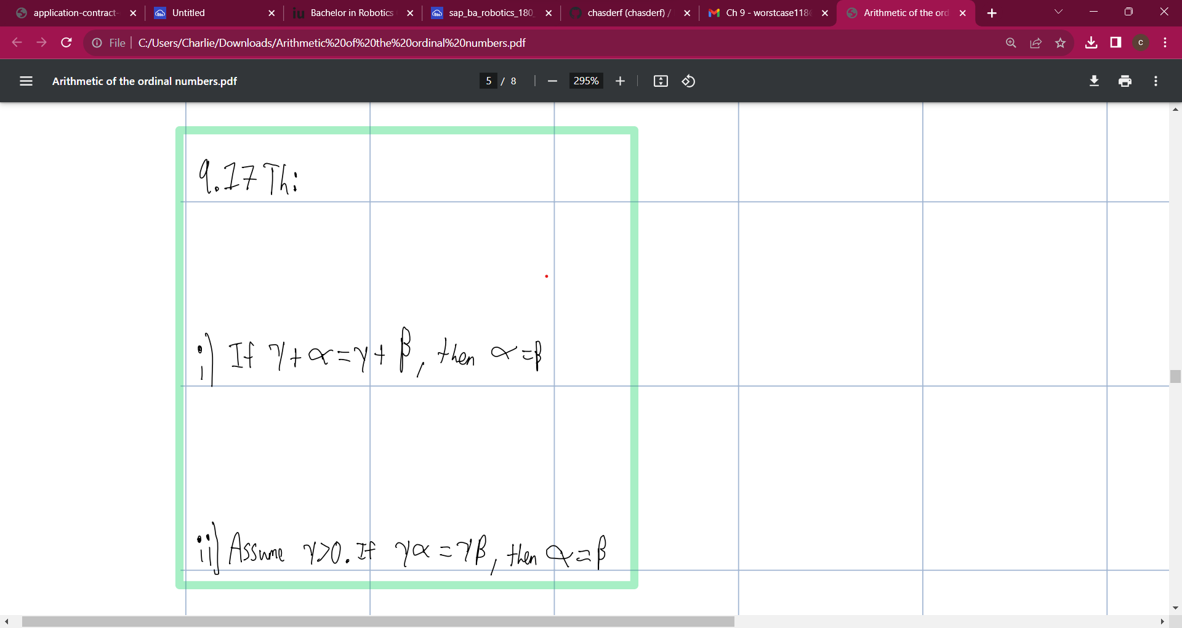
TWO YEAR ACTION PLAN
FEB 20XX
Draft blueprints
MAR 20XX
Test designs
APR 20XX
Run focus groups
MAY 20XX
Launch design
JUN 20XX
Gather feedback

Slide 17
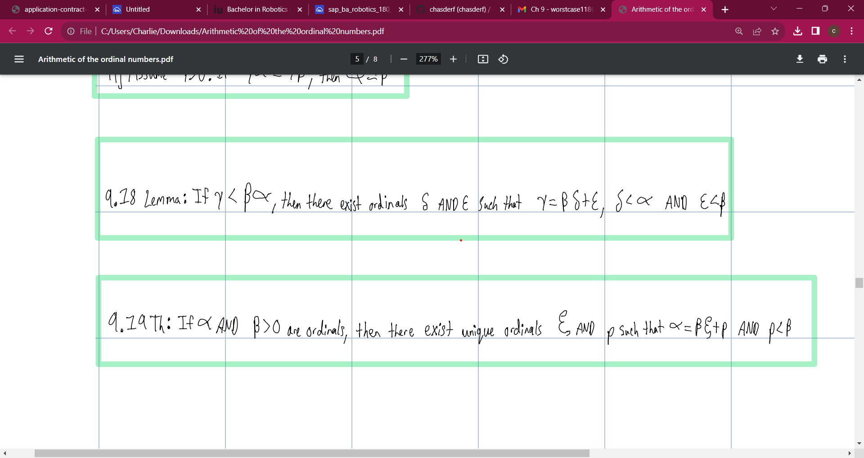
B2B market scenarios
Develop winning strategies to keep ahead of the competition
Capitalize on low hanging fruit to identify a ballpark value
Visualize customer directed convergence
Iterative approaches to corporate strategy
Establish a management framework from the inside

Slide 18
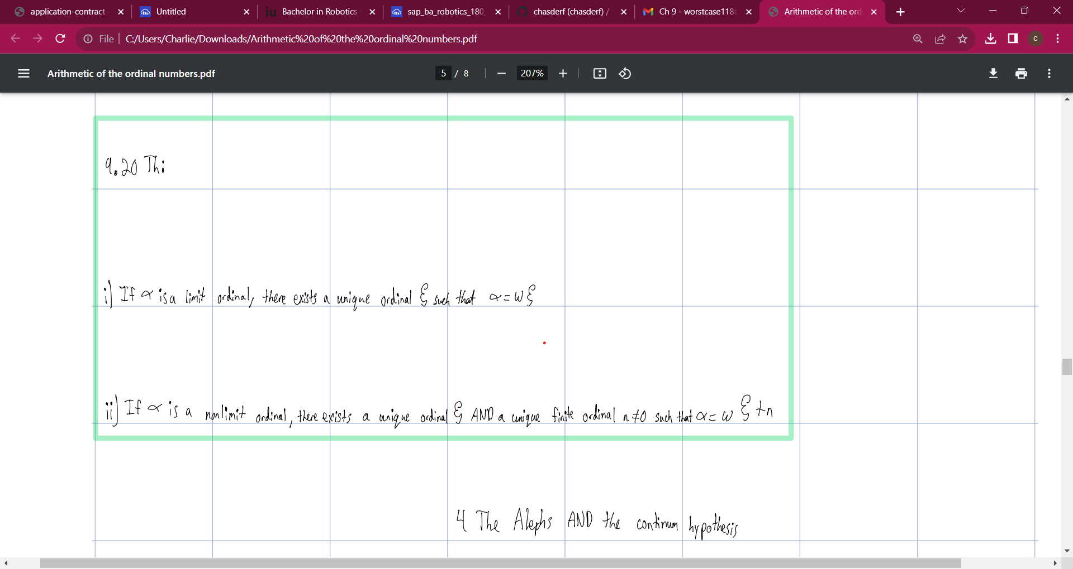
Two content
At Contoso, we empower organizations to foster collaborative thinking to further drive workplace innovation. By closing the loop and leveraging agile frameworks, we help business grow organically and foster a consumer-first mindset.
At Contoso, we empower organizations to foster collaborative thinking to further drive workplace innovation. By closing the loop and leveraging agile frameworks, we help business grow organically and foster a consumer-first mindset.

Slide 19
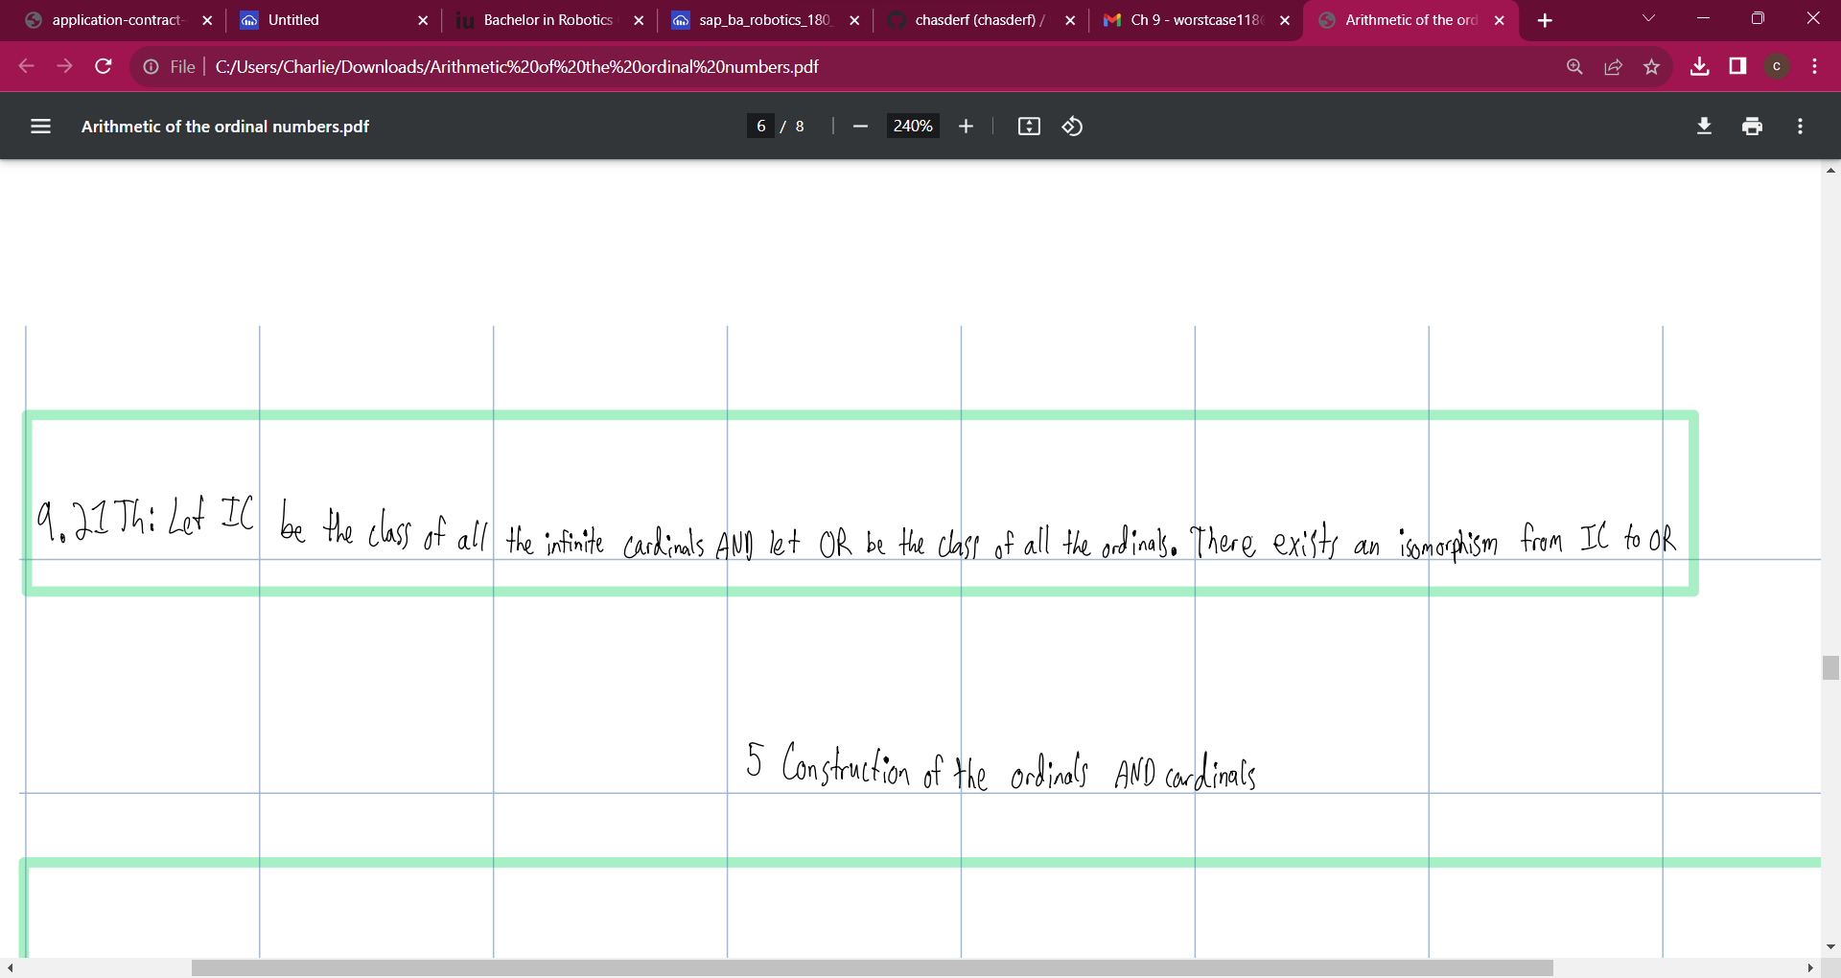
Two content
At Contoso, we empower organizations to foster collaborative thinking to further drive workplace innovation. By closing the loop and leveraging agile frameworks, we help business grow organically and foster a consumer-first mindset.
At Contoso, we empower organizations to foster collaborative thinking to further drive workplace innovation. By closing the loop and leveraging agile frameworks, we help business grow organically and foster a consumer-first mindset.

Slide 20
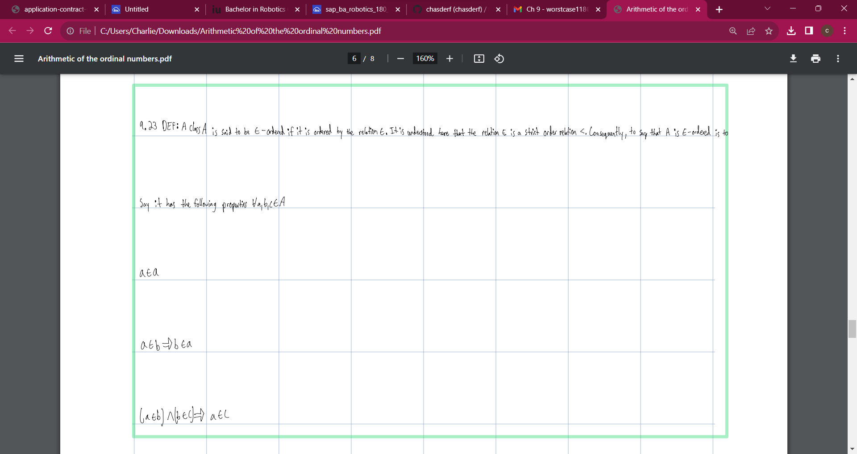
FINANCIALS
 | Year 1 | Year 2 | Year 3
INCOME
Users | 50,000 | 400,000 | 1,600,000
Sales | 500,000 | 4,000,000 | 16,000,000
Average price per sale | 75 | 80 | 90
Revenue @ 15% | 5,625,000 | 48,000,000 | 216,000,000
Gross profit | 5,625,000 | 48,000,000 | 216,000,000
EXPENSES
Sales & marketing | 5,062,500 | 38,400,000 | 151,200,000 | 70%
Customer service | 1,687,500 | 9,600,000 | 21,600,000 | 10%
Product development | 562,500 | 2,400,000 | 10,800,000 | 5%
Research | 281,250 | 2,400,000 | 4,320,000 | 2%
Total expenses | 7,593,750 | 52,800,000 | 187,920,000

Slide 21
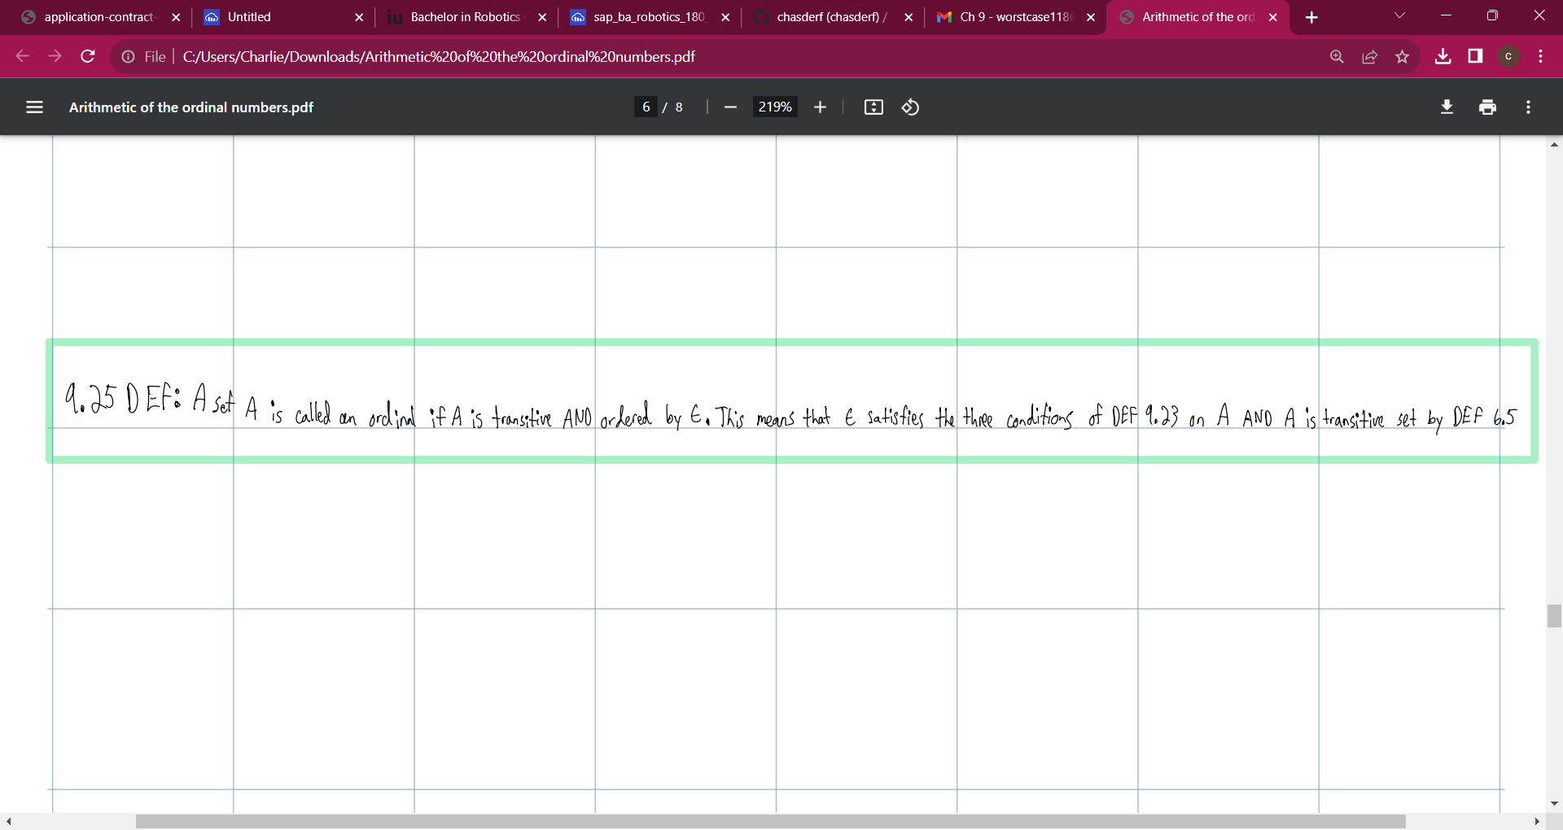




MEET THE TEAM
Takuma Hayashi
Mirjam Nilsson
Flora Berggren
Rajesh Santoshi
President
Chief Executive Officer
Chief Operations Officer
VP Marketing

Slide 22
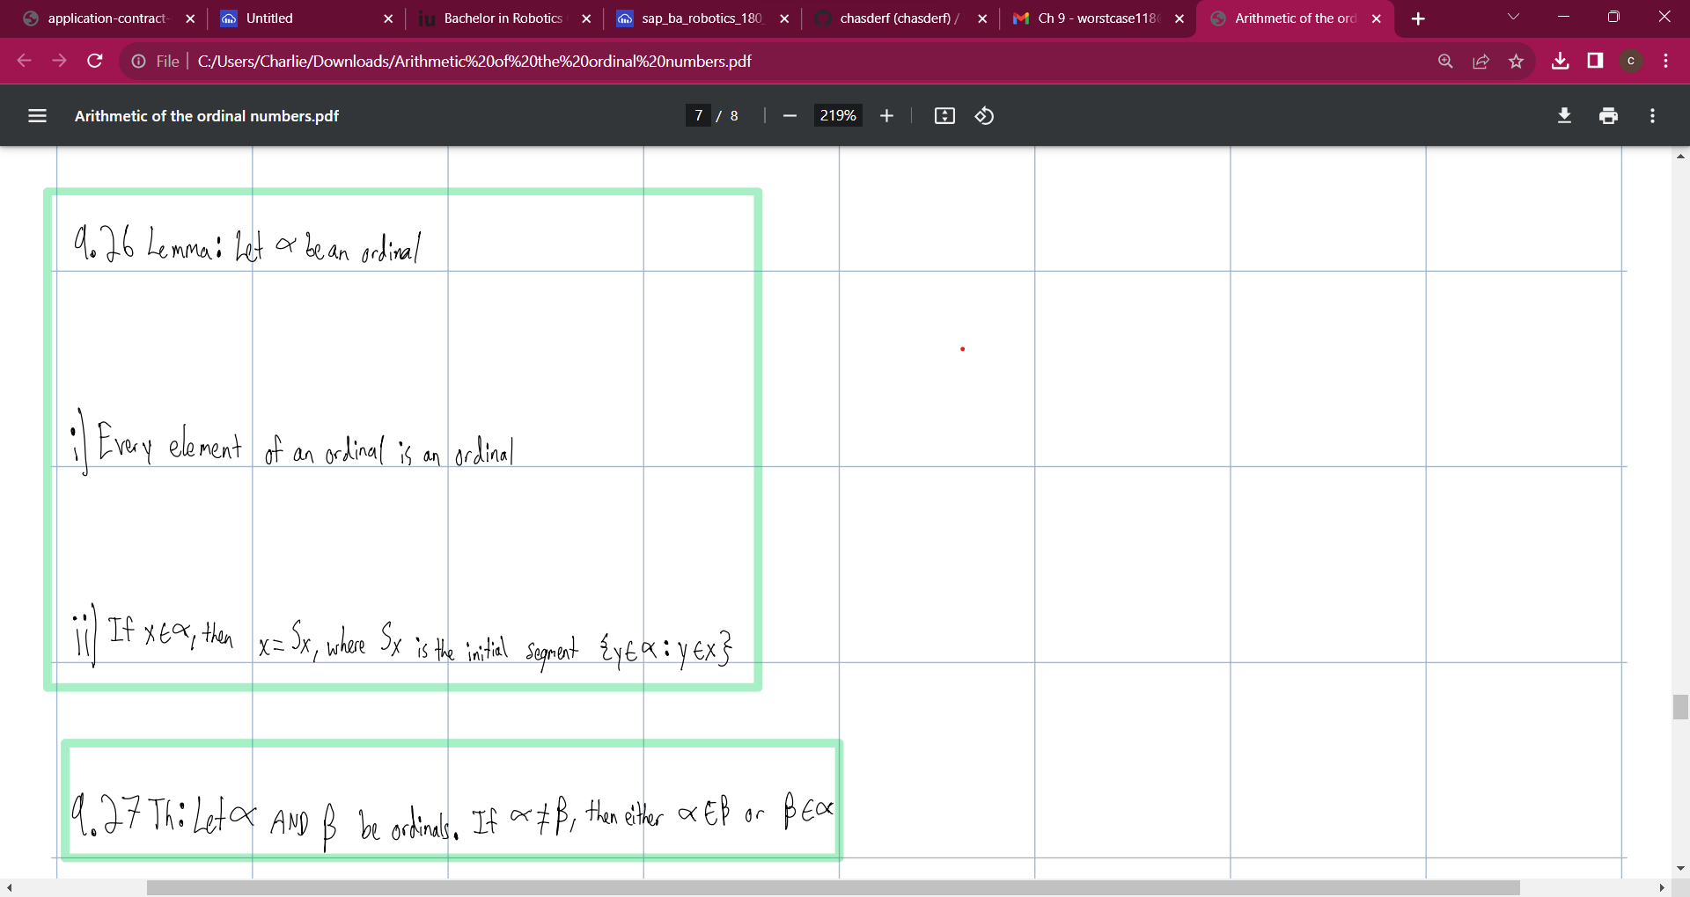








MEET THE TEAM
Takuma Hayashi
Mirjam Nilsson
Flora Berggren
Rajesh Santoshi
President
Chief Executive Officer
Chief Operations Officer
VP Marketing
Graham Barnes
Rowan Murphy
Elizabeth Moore
Robin Kline
VP Product
SEO Strategist
Product Designer
Content Developer

Slide 23
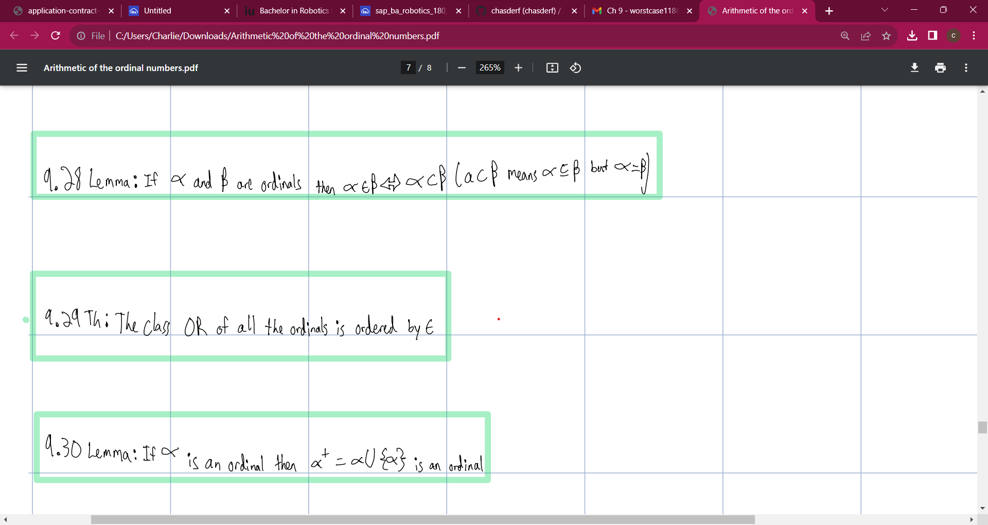
SUMMARY
At Contoso, we believe in giving 110%. By using our next-generation data architecture, we help organizations virtually manage agile workflows. We thrive because of our market knowledge and great team behind our product. As our CEO says, "Efficiencies will come from proactively transforming how we do business."

Slide 24
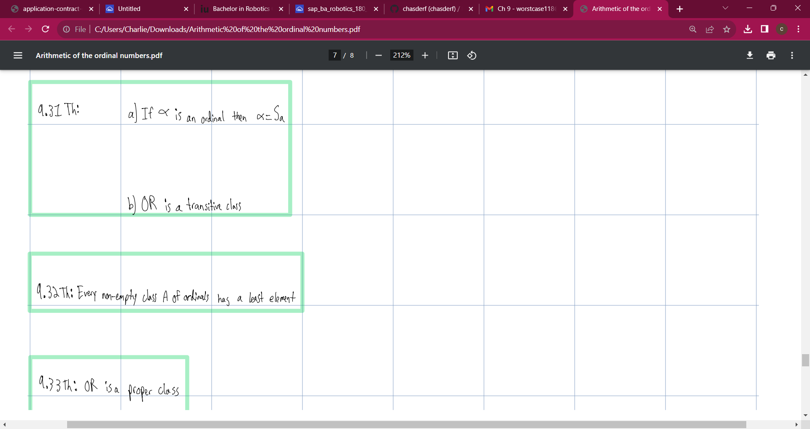
THANK YOU
Mirjam Nilsson
206-555-0146
mirjam@contoso.com
www.contoso.com

Slide 25
